Slide 1
Agentic RAG Chatbot for Multi-Format Document QA using Model Context Protocol (MCP)
Presented by
Ch Praneeth

Slide 2
Structure & Model Context Protocol(MCP)
Ingestion Agent: Parses documents, performs cleaning, and splits content into chunks.
Retrieval Agent: Handles chunk embedding, vector storage (indexing), and semantic retrieval based on the user query.
LLM Response Agent: Receives the query and context, formats the final prompt, and calls the Large Language Model to generate the final answer.
Coordinator Agent receives the files and initiates the indexing process.

Slide 3
End-to-End RAG Workflow
Indexing phase - 1. UI → Coordinator: Sends files. → 2. Coordinator → Ingestion Agent: Sends MCP: INGESTION_COMMAND. → 3. Ingestion Agent → Retrieval Agent: Sends MCP: CONTEXT_TRANSFER (chunk data). → 4. Retrieval Agent: Indexes chunks in Vector DB.
Querying phase - 5. UI → Coordinator: Sends user query. → 6. Coordinator → Retrieval Agent: Sends MCP: QUERY_REQUEST. → 7. Retrieval Agent → LLM Agent: Sends MCP: RETRIEVAL_RESULT (query + context). → 8. LLM Agent → Coordinator: Sends MCP: FINAL_ANSWER (answer + source). → 9. UI: Displays result.

Slide 4
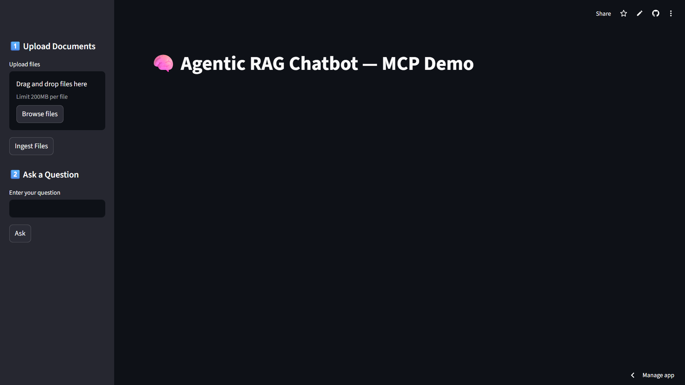
UI Screenshot

Slide 5
Tech Stack & Choices
UI: Streamlit (simple, quick demo)
Embeddings: sentence-transformers or external APIs
Vector DB: FAISS / Chroma (indexing stub provided)
MCP: in-memory bus (can be swapped for Redis/pubsub).

Slide 6
Challenges & Future Scope
Protocol Consistency: Ensuring the trace_id was maintained across all four agents. Solution: Centralizing ID generation and routing through the Coordinator Agent.
Document Parsing: Cleaning complex elements (tables, headers) from PDF/DOCX to create clean chunks for the Ingestion Agent. Solution: Utilizing specialized text splitting libraries tailored for code/tables.
Future: multi-agent planning, tool use, memory, role-based access.

